Slide 1
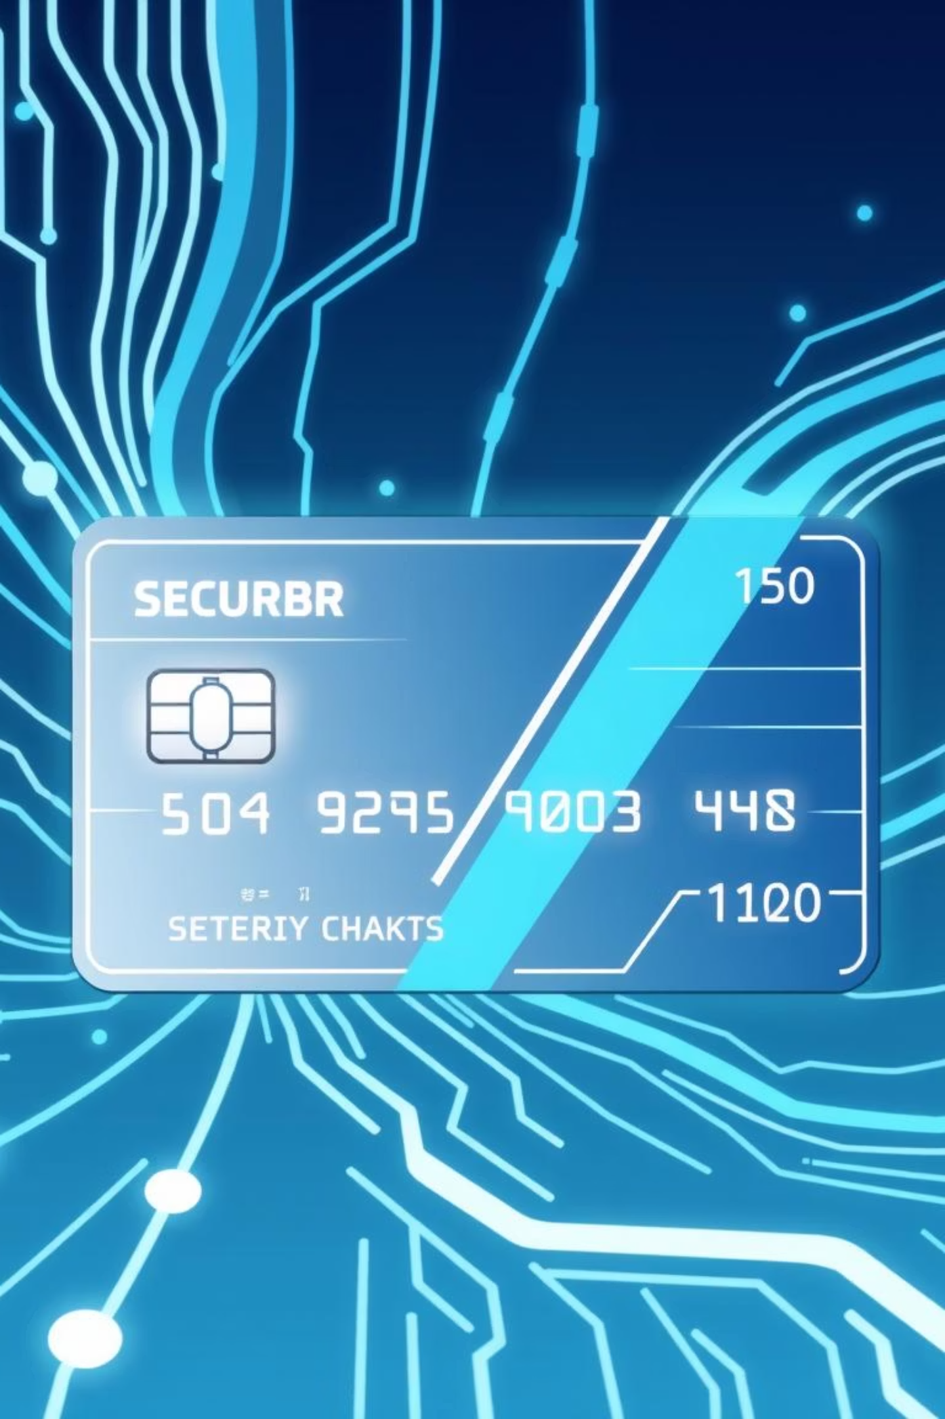

Bachelor of Engineering(Software Engineering)
Presented by:
Amna Tariq
Section:
Regular
Roll No:
2225165004
Semester:
7th
Presented To:
Dr. Mohsin Nazir
Course:
Applied Data Science with AI

Slide 2

PROJECT:
Credit Card Fraud Detection Using
Machine Learning and Deep Learning
Introduction: Combating Digital Fraud
The surge in digital payments has led to a significant increase in credit card fraud, rendering traditional detection methods inefficient. This project aims to develop an advanced AI-based fraud detection system leveraging Machine Learning, Deep Learning and unsupervised learning techniques.

Slide 3






Project Objectives
Data Preparation
Feature Engineering
Model Development
Preprocess and clean transaction data for optimal model performance.
Explore datasets and select the most predictive features.
Build and compare various ML and DL models.
Real-time Deployment
Model Explainability
Deploy models via Flask API for live predictions.
Utilize SHAP & LIME for transparent prediction insights.

Slide 4


Dataset Overview & Preprocessing
Transaction Dataset
Data Preprocessing Steps
We used a credit card transaction dataset with 30 features.
A key challenge was the extreme class imbalance: less than 1% of transactions were fraudulent.
Rigorous preprocessing was crucial to handle the dataset's complexities.
Data cleaning: Removed duplicates, handled missing values, and outliers.
Features: V1–V28, Amount, Class
Feature scaling: Applied StandardScaler to normalize features.
Imbalance: Fraud < 1%
Imbalance handling: Employed techniques to address the skewed fraud
distribution.

Slide 5
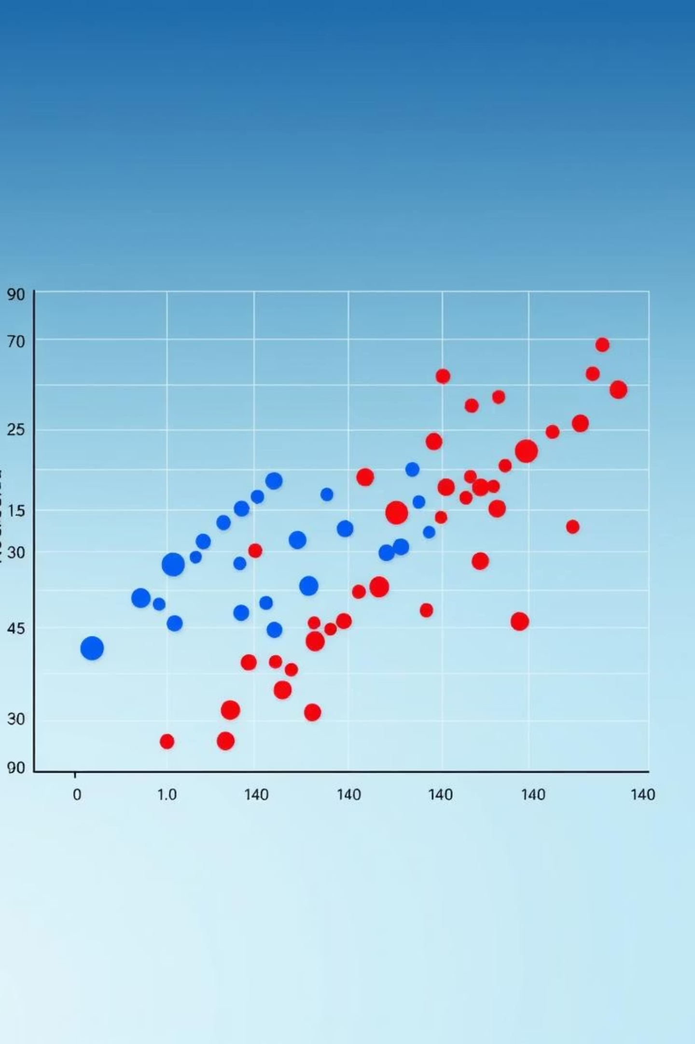






Exploratory Data Analysis (EDA)
Fraud Distribution
Feature Correlation
Analyzed the stark contrast between fraudulent and non-fraudulent transactions.
Identified V12, V14 and V17 as top predictors due to strong correlations.
Anomaly Patterns
Detected unusual patterns and anomalies within the 'Amount' feature.

Slide 6



Machine Learning Models
Logistic Regression
Random Forest
Served as the baseline model, providing initial performance metrics.
Demonstrated superior recall and accuracy compared to the baseline.
Models were evaluated using Accuracy, Precision, Recall, F1-Score and ROC-AUC to ensure comprehensive performance assessment.

Slide 7


Deep Learning Models
Artificial Neural Network (ANN)
Recurrent Neural Network (RNN/LSTM)
Utilized two hidden layers, trained on scaled numeric features, leading to improved accuracy in fraud detection.
Designed to capture sequential patterns in transaction data, significantly enhancing recall for fraudulent activities.

Slide 8

Unsupervised Learning & Model Evaluation
Unsupervised Techniques
Model Performance Summary
K-Means Clustering: Identified hidden clusters of
fraudulent transactions.
Model
Accuracy
Precision
Recall
F1-Score
ROC-AUC
Logistic Regression
Moderate
Moderate
Low
Moderate
0.81
PCA: Reduced dimensionality and visualized anomalies effectively.
Random Forest
High
High
High
High
0.93
ANN
High
High
High
High
0.92
RNN/LSTM
High
High
Higher
High
0.94

Slide 9

Model Deployment with Flask API
Real-time Predictions
A Flask API was developed to enable real-time fraud predictions. It accepts JSON input and returns immediate fraud detection results on localhost.
Challenges Encountered
Deployment faced challenges related to handling large datasets and ensuring correct input formatting for accurate predictions.

Slide 10

Explainability & Industry Relevance
Model Explainability
To ensure transparency, SHAP and LIME were used to explain model predictions.
SHAP: Provided global and local feature importance.
LIME: Explained individual prediction outcomes.
Key Features: V14, V17, V12, and Amount were identified as most influential.
Industry Impact
This project holds significant relevance across various sectors:
Banking: Enables real-time fraud monitoring.
Payment Networks: Enhances security for Visa, Mastercard, PayPal.
E-commerce & Fintech: Protects online transactions and builds customer trust.

